Slide 1
Research and Public Health Emergencies
Sage Assembly Webinar Series
Host: Meg Doerr
Discussants: Jennifer K. Wagner and Kayte Spector-Bagdady

Slide 2
Sage Bionetworks Code of Conduct
Be welcome & inclusive.
Participate in an authentic & active way.
Respect the viewpoints & ideas of others.
Attempt collaboration before conflict.
Refrain from demeaning, discriminatory, or harassing behavior & speech.
Show empathy & kindness when interacting with others.

Slide 3
Disclosures
The seed for this webinar came from a number of sources including direct conversation, email, and Twitter and has since been informed by review of academic, popular, and emerging literature, and loads more conversation (direct, Twitter). Prof. Spector also wrote a piece in USA Today about the importance of research during the pandemic.
The views presented and discussed today are the personal views of the presenters, do not constitute legal or ethical advice, and should not be used to justify decision making.

Slide 4
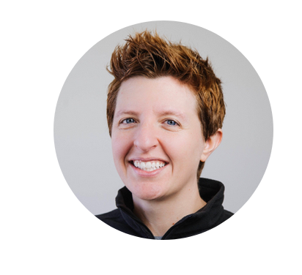
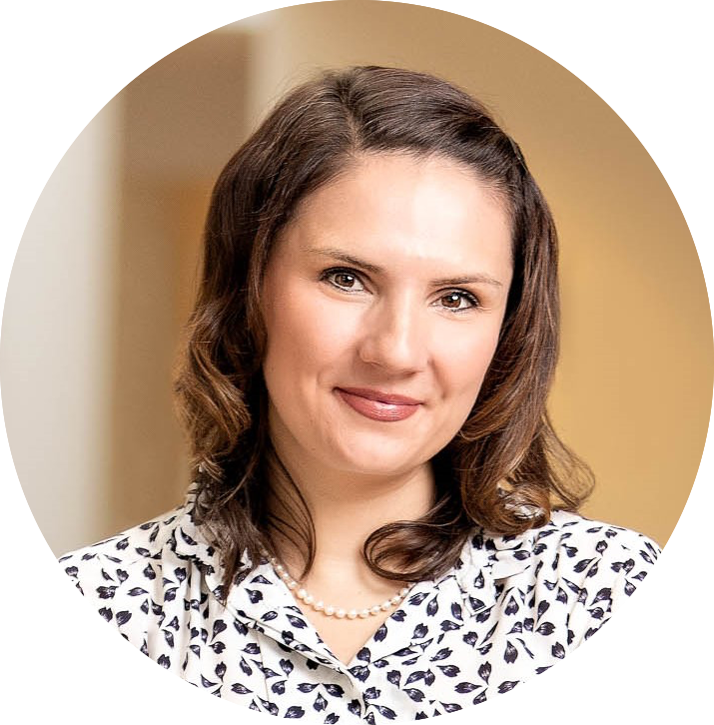
Our discussants
Jennifer K. Wagner, JD, PhD
Kayte Spector-Bagdady, JD, MBe
Dr. Wagner is associate director of bioethics research and assistant professor in the Center for Translational Bioethics & Health Care Policy at Geisinger. Her research is multidisciplinary and focused at the intersections of anthropology, genetics, law, and bioethics.
Professor Spector is a lawyer/bioethicist and Chief of the Research Ethics Service in the Center for Bioethics and Social Sciences in Medicine at the University of Michigan Medical School. Her research focuses on the secondary research use of health data and biospecimens.

Slide 5
Our plan for today
Setting the stage (Meg)
Questions and discussion (with Jen and Kayte)

Slide 6
Setting the stage

Slide 7
We are undeniably in the midst of a pandemic
Image: Johns Hopkins University CSSE

Slide 8
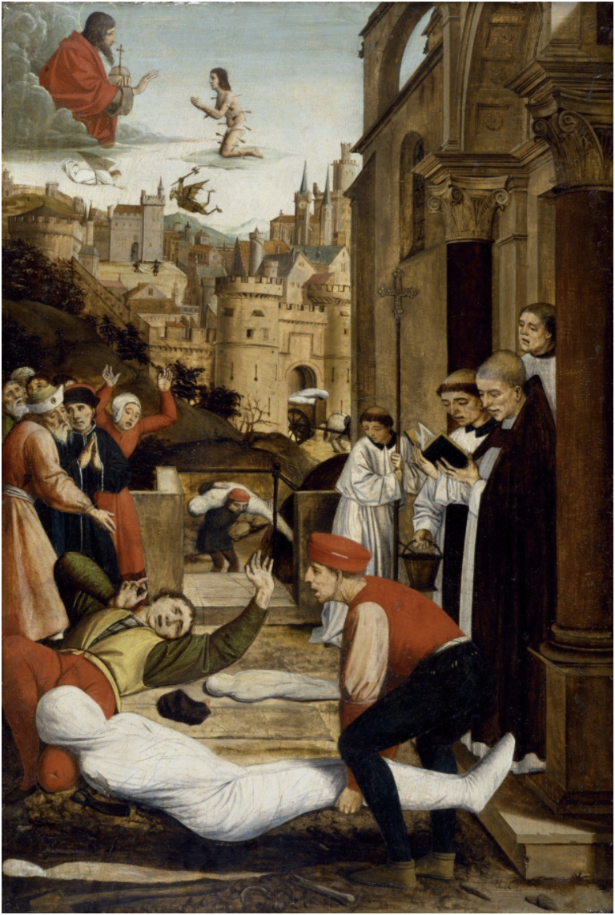
As in past pandemics, much is unknown
Who has it?
Who has had it?
Once you’ve had it, can you get it again?
Why is it terrible for some people and mild for others?
How long has it been circulating in humans?
Image: Josse Lieferinxe Library of Congress
Notes:
If it were known, it wouldn’t likely be a pandemic, now would it?!

Slide 9
This pandemic is a little different
We have massive research banks filled with data and biosamples
We have oodles of computing power
In many cases we have “broad consent” – informed consent that allows for secondary research

Slide 10
Case example: Seattle Flu Study
Since 2018, SFS had gathered nasal swabs to follow the spread of influenza in Seattle
In early Feb. 2020, SFS proposed using samples to track COVID-19 spread to state and federal officials
The officials said no.
SFS did not have the explicit consent of participants to test samples for COVID-19 or to return these results to them
SFS was not certified to provide COVID-19 results
SFS primarily used research laboratories (not CLIA Certified)
SFS coronavirus test itself was not approved by FDA
Image: @PHNurseMichelle
Twitter

Slide 11
Can we use research repositories in a public health emergency? Should we? Public health activities are not the same as public health research
Image: David Lahti

Slide 12
What is research?
Research is a systematic investigation designed to develop or contribute to generalizable knowledge
Human subjects research involves living people about whom an investigator gathers data or samples through direct interaction, intervention, or through identifiable private information
Body fluids
Tissues
Recorded information
Public health research is research that focuses on public health. An IRB determines if it is also human subjects research.
Generalizable
knowledge

Slide 13
There are regulations
The Federal Policy for the Protection of Human Subjects. 82 Fed. Reg. 7149 (January 19, 2017), codified at 45 C.F.R. §46 aka the Common Rule
Lays out researcher responsibilities for human subjects research including:
Informed Consent
Institutional Review Boards
Literally born out of misconduct of public health research
The Food and Drug Administration (FDA) also has research oversight responsibilities
Image: National Archives

Slide 14
But not all research is regulated…
The Common Rule applies to federally funded research
FDA oversight is very specific
Arguably MOST data right now is found in private repositories (Google, FitBit, Facebook, etc).
Image: keriberrygirl.deviantart.com

Slide 15
What are public health activities?
Is intended to prevent a disease or injury and improve health (or to improve a current, on-going public health program or service) AND it is designed to benefit the people in the activity
Focus: assessment, assurance, and/or policy development
May use same techniques, data, analysis approaches as research and may also result in generalizable knowledge
Image: CDC

Slide 16
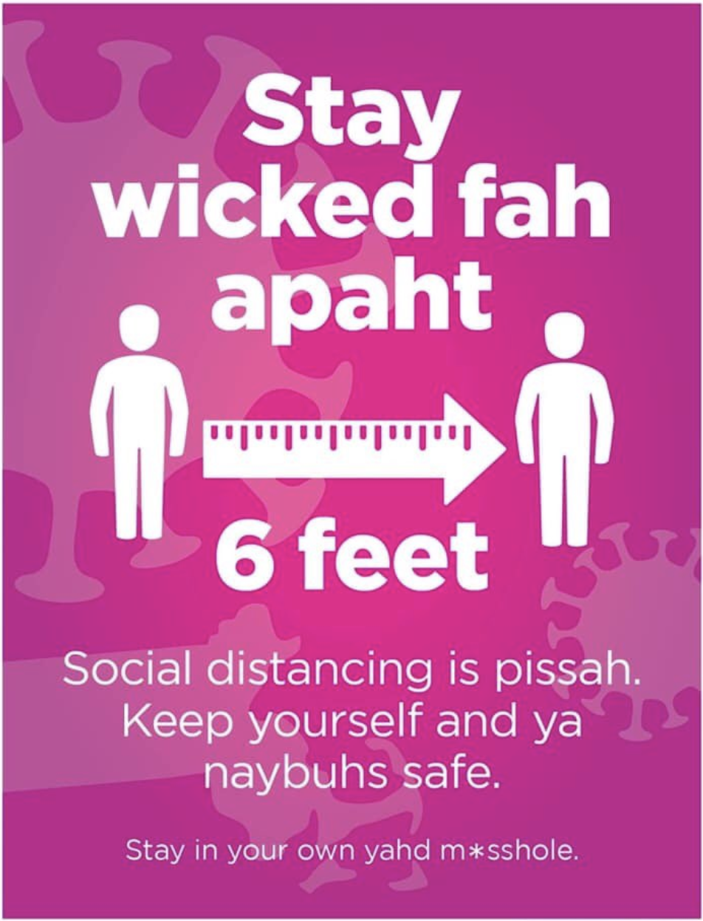
Regulation of public health activities
Public health activities are “not research” under the Common Rule [45 CFR 46.102(l)(2)]
Common Rule notes that public health activities “use information and biospecimens from a variety of sources”
Scholarly support that the practice of public health is not itself research
Uniquely in the US, most public health activities are authorized by state (not federal) statute
Image: David Linde
Emerge Design Group
Notes:
“During colonial times, public health,
including quarantine, was a matter for the colonies, and therefore when the Constitution was drafted,
public health was not one of the enumerated powers granted to the new federal government and was
reserved to the states. Consequently, the U.S. is one of the few nations without a national public health
agency.” (Rothstein 2020)

Slide 17
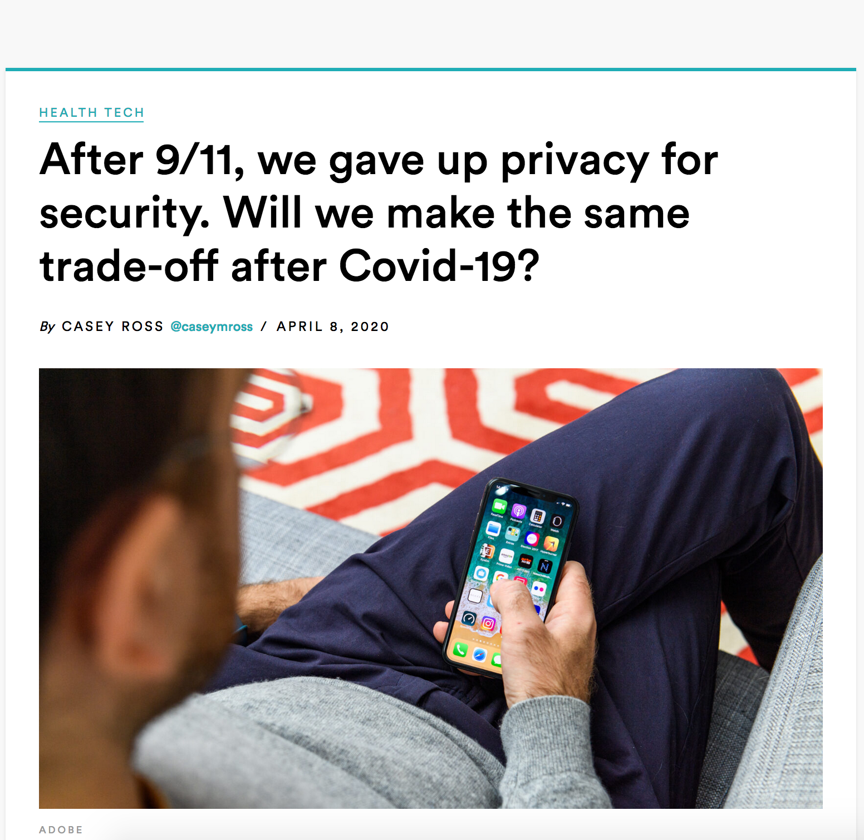
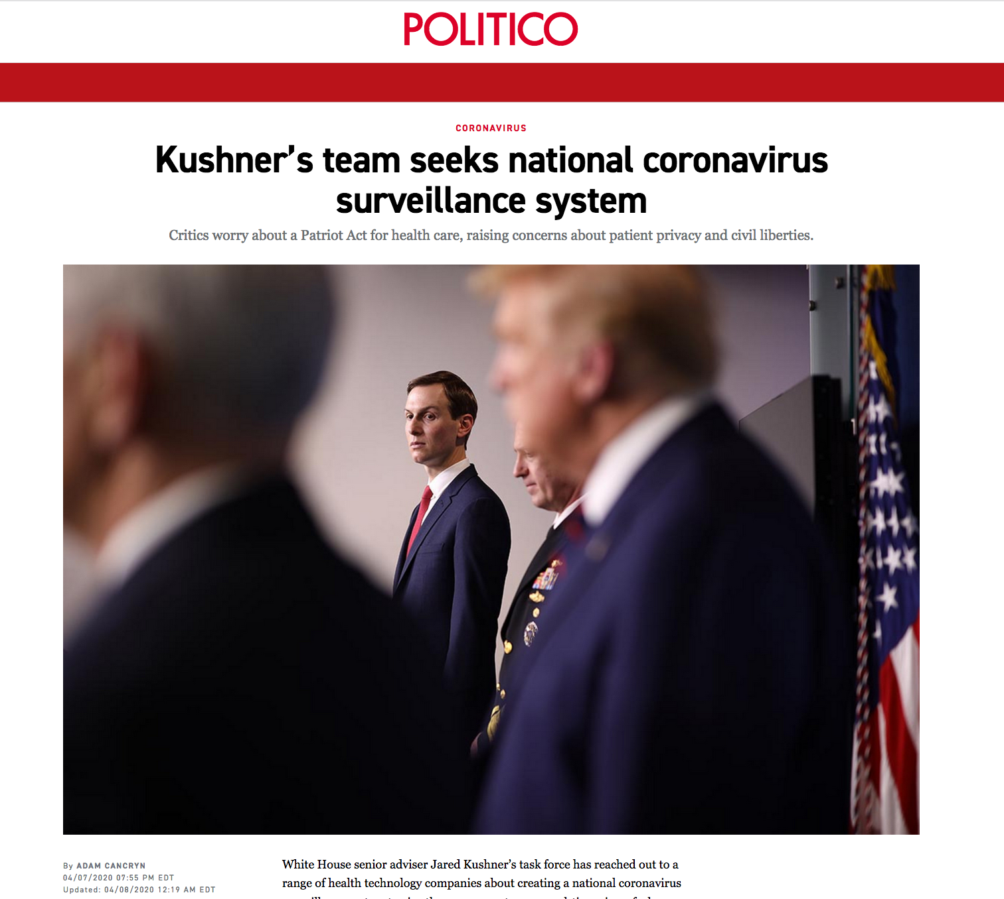
So what’s the problem?
Who gets to define a public health emergency?
Some researchers may call their research public health activities to get around the research regulations
There are very few stops on public health activities (especially in a public health emergency)

